Slide 1
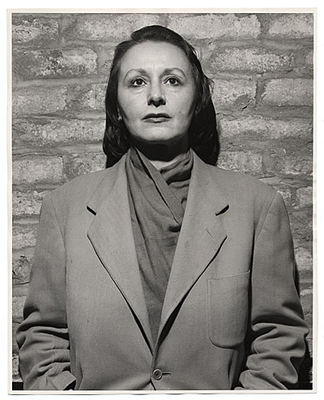
Louise Nevelson
(1900-1988)
Born September 23, 1900

Slide 2
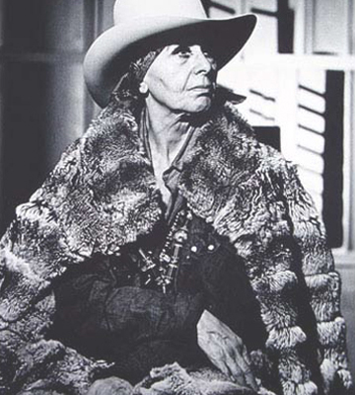
In the late '50s Nevelson began producing her well-known "sculptural walls"—large freestanding arrangements of shallow vertical boxes filled with pieces of wood and miscellaneous objects such as driftwood, wheels, knobs, and chair slats.
These works were usually painted a single color, notably black, but sometimes white or gold.

Slide 3
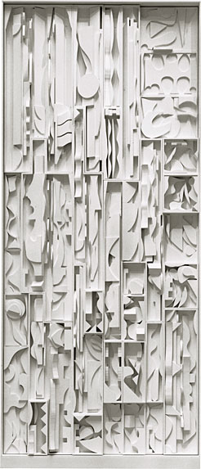
White Vertical Water, 1972. Painted wood, 26 sections, 216 x 108 inches overall. Solomon R. Guggenheim Museum, Gift, Mr. and Mrs. James J. Shapiro. 85.3266.a-.z. Louise Nevelson © 2001 Artists Rights Society (ARS), New York.

Slide 4
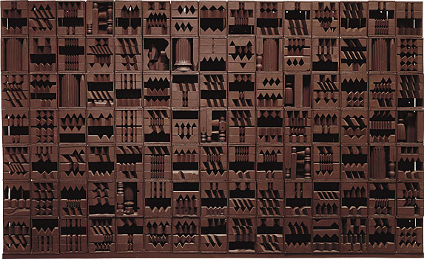
Luminous Zag: Night, 1971. Painted wood, 105 boxes, 120 x 193 x 10 3/4 inches overall. Solomon R. Guggenheim Museum, Gift, Mr. and Mrs. Sidney Singer. 77.2325.a-.bbbb. Louise Nevelson © 2001 Artists Rights Society (ARS), New York.

Slide 5
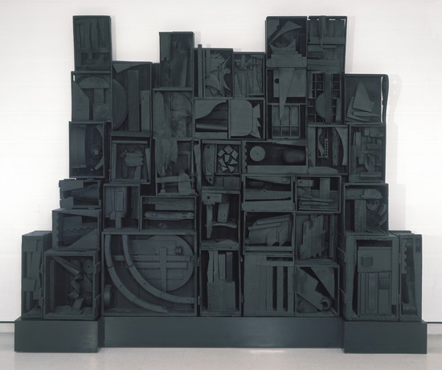
Sky Cathedral, 1958 wood, painted black, 115 x 135 x 20" George B. and Jenny R. Mathews Fund, 1970

Slide 6
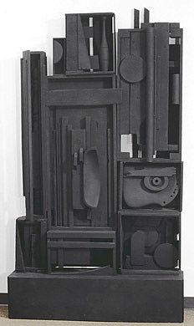
Lunar Landscape Painted wood, 1959-60 Amon Carter Museum, Fort Worth, Texas Ruth Carter Stevenson Acquisition Endowment 1999.3.A-J

Slide 7
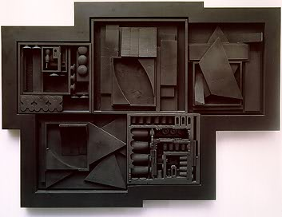
Black Zag Z, 1969, Black painted wood sculpture in black formica frame

Slide 8
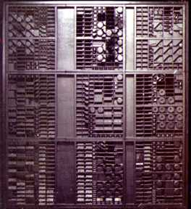
End of Day Nightscape V, 1973 Painted wood

Slide 9
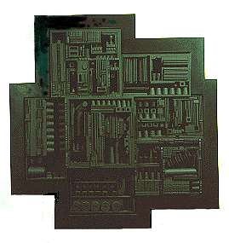
Black Zag A, 1968 Wood, found objects, pigment, plastic laminate 45 3/4 x 44 x 6 1/2 in.

Slide 10
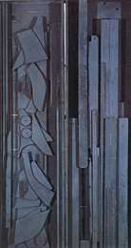
Paneles en sombra, 1961 madera y pintura, 218 x 115.5 x 11.3 adquisición Instituto Di Tella, 1973

Slide 11
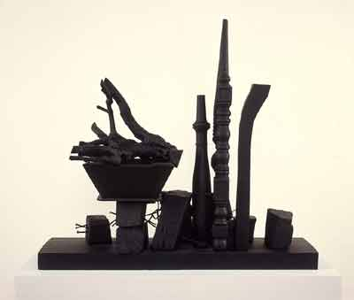
Night Landscape
1955
Wood painted black
35 1/2 x 38 1/2 x 15 in.
The Museum of Contemporary Art, Los Angeles

Slide 12
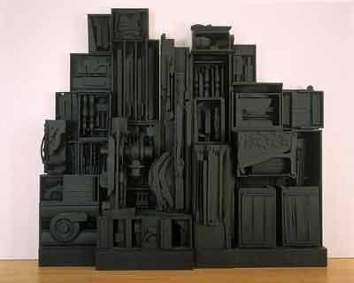
Sky Cathedral
Southern Mountain
1959
Black painted wood
114 x 124 x 16 in.
The Museum of Contemporary, Los Angeles

Slide 13
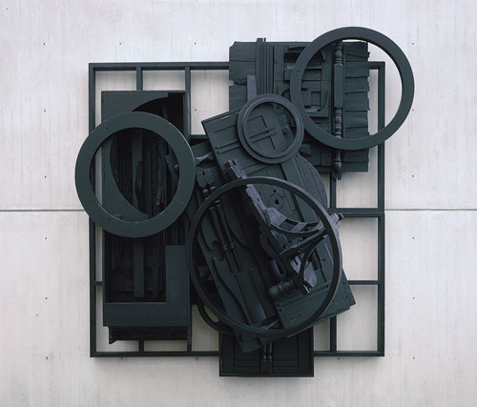
Mirror-Shadow VIII, 1985 Wood with paint Height 114 in. (289.6 cm)

Slide 14
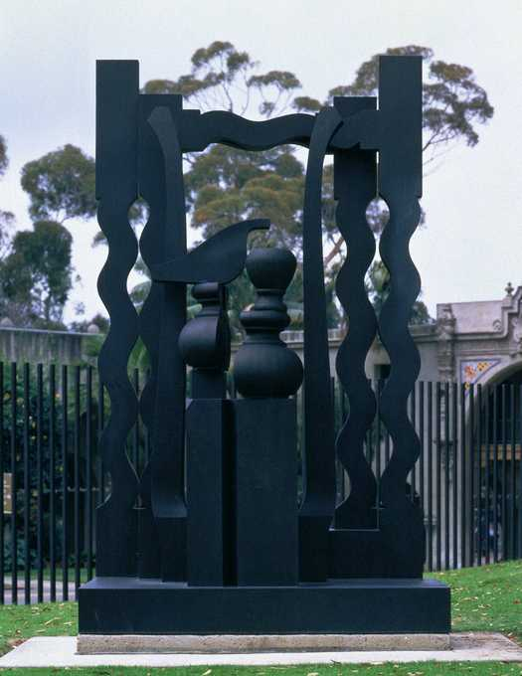
Night Presence
1976:137
1976, USA

Slide 15
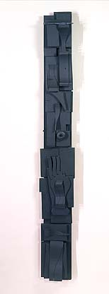
Sky Totem 1956 Louise Nevelson painted wood 70 3/4 x 9 3/8 x 5 1/2 in. (179.7 x 24.0 x 14.0 cm.) Smithsonian American Art Museum

Slide 16
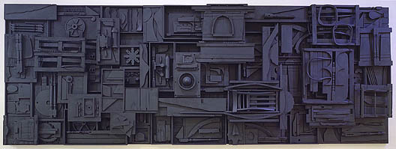
Sky Cathedral 1982 Louise Nevelson painted wood overall: 104 3/8 x 288 3/8 x 15 3/4 in. (265.1 x 732.5 x 40.0 cm.) Smithsonian American Art Museum

